Slide 1
TEMPERATURE CONTROLLED FAN
DAMLA AYDIN 2003959
MÜCAHİD ENES DENİZ 2003376
MERT ERDEM GÜNEŞ 2002925
DİLARA ÇOBAN 2003470

Slide 2
CONTENTS
AIM OF THE PROJECT
ELECTRONICS
CODING

Slide 3
AIM OF THE PROJECT
The aim of the project is to dynamically control the speed of a fan based on data from a temperature sensor. This allows adjusting the performance of the fan according to the ambient temperature. The goal is to effectively regulate the temperature of the environment or cool it as desired by ensuring the fan operates efficiently.

Slide 4
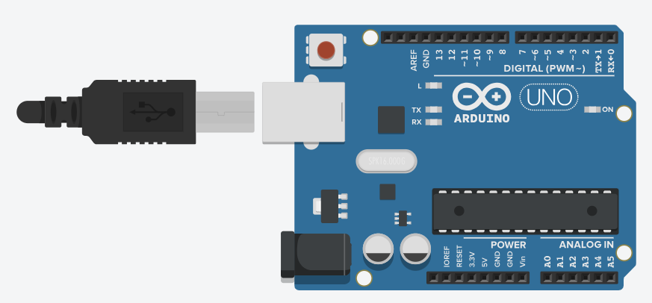
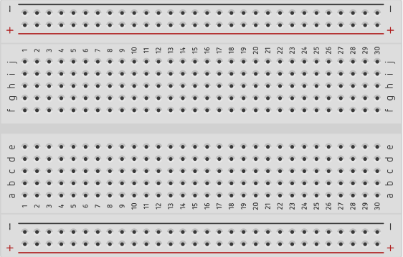

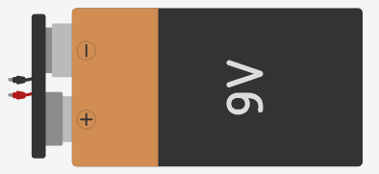

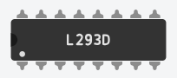
COMPONENTS THAT WE USED FOR THE CIRCUIT
ARDUNIO UNO R3
BREADBOARD SMALL
DC MOTOR
The Arduino Uno R3 is a development board used for developing microcontroller-based projects.
A small breadboard is a tool used to temporarily place and connect components when creating electronic circuits.
DC motors are devices that convert electrical energy into mechanical energy to provide motion.
9V BATTERY
TEMPERATURE SENSOR
H BRIDGE MOTOR DRIVER
TS detects environmental temperature values and enables reading temperature data by connecting to Arduino's digital or analog input pins.
The H-bridge motor driver is used to control the direction and speed of DC motors.
The 9v battery is a commonly used power source in electronic projects, providing approximately 9 volts of voltage.

Slide 5
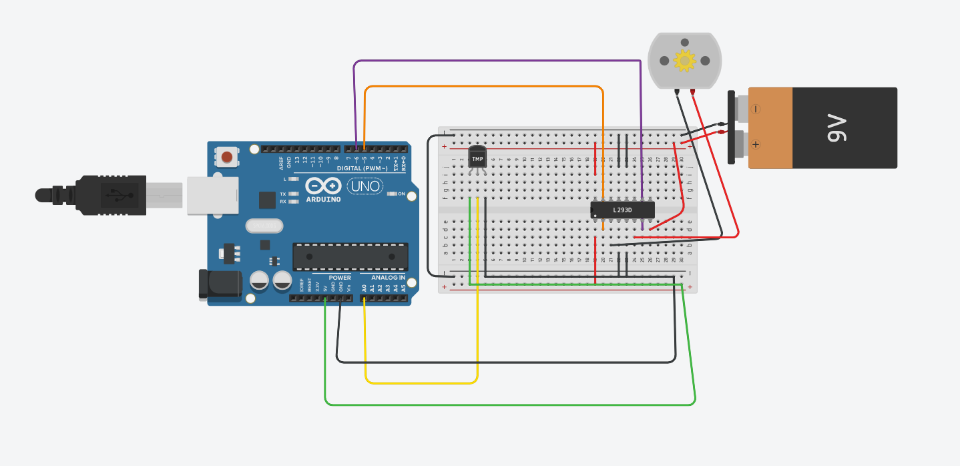

Slide 6
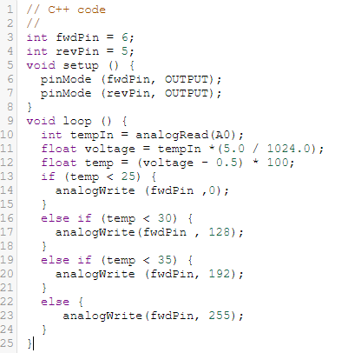
THE DEFINITION OF VARIABLES
int fwdPin = 6;
int revPin = 5;
The variables fwdPin and revPin contain the pin numbers to be used for the forward and reverse directions of the motor.
THE SETUP FUNCTION
void setup () {
pinMode (fwdPin , OUTPUT);
pinMode (revPin , OUTPUT);
}
The pinMode() function is used to set the Arduino pins to a specific mode of operation.
fwdPin and revPin are configured as output pins, indicating that they will be used to control the motor.

Slide 7
THE LOOP FUNCTION
Temperature Reading
void loop () {
int temIn = analogRead(A0);
The analogRead(A0) function reads an analog voltage value representing the temperature data from the sensor and returns it as an integer between 0 and 1023.
This read value is assigned to the tempIn variable.
Voltage Calculation
Float voltage = tempIn * (5.0 / 1024.0) ;
To convert the read value to voltage, a ratio between the 5-volt supply voltage and the resolution of the ADC (1024) is calculated.
The read value is multiplied by this ratio to obtain the voltage value, which is then assigned to the voltage variable.

Slide 8
Temperature Calculation
Float temp = (voltage – 0.5) * 100;
Since the sensor output voltage is typically around 0.5 volts, this offset value (0.5) is subtracted from the voltage value.
The resulting voltage value is converted to temperature in Celsius. This conversion is based on a formula provided in the sensor's datasheet.
The calculated temperature value is assigned to the temp variable and is used to determine the speed of the motor.

Slide 9
SPEED CONTROL
if (temp<25) {
analogWrite (fwdPin,0);
}
If the temperature is below 25 degrees, the motor is stopped.
if (temp<30) {
analogWrite (fwdPin,128);
}
If the temperature is between 25 and 30 degrees, the motor operates at low speed.
if (temp<35) {
analogWrite (fwdPin,192);
}
If the temperature is between 30 and 35 degrees, the motor operates at medium speed.
else {
analogWrite (fwdPin,255);
}
If the temperature exceeds 35 degrees, the motor operates at maximum speed.

Slide 10
THANK YOU FOR THE LISTENING ☺

